Slide 1
Upset Potential in the National Football League (NFL)
Mary J. Snyder
Advisor: Michael P. McGuire Ph.D.

Slide 2
Agenda
Introduction
Dataset
Experiment Design, Tools, & Approaches
Results
Conclusion

Slide 3
Introduction
Background
Abstract
Determining factors that influence the potential for upsets in the NFL
Objectives
Fun applications
Fantasy Football
Spread or confidence point picks leagues
Team preparation
Identify steps to protect themselves
Focus their training to upset other teams

Slide 4
Dataset
Data attribute selection
Game information
Team, score, outcome, week
Statistics related
Injuries, average points for, average points against
Outside influence
Weather, time zone, time of games, number of days rest between games
Challenges
Injuries per position
Weather
Game time
Sources
Historical databases, NFL.com, weather databases

Slide 5
Experiment Design, Tools, & Approaches
Data Analysis
Preprocessing: Binning
Pairs, Scatterplots, Histograms
Magnitude of Upset
Clustering
DBSCAN, K-Means
Classification
Decision Tree, Naïve Bayes
Upset
Classification
Decision Tree, Naïve Bayes
Holdout method - 70/30 split
Past years to predict current year

Slide 6
Results
Data Analysis
Magnitude of Upset (UpsetAmt)
Upset

Slide 7
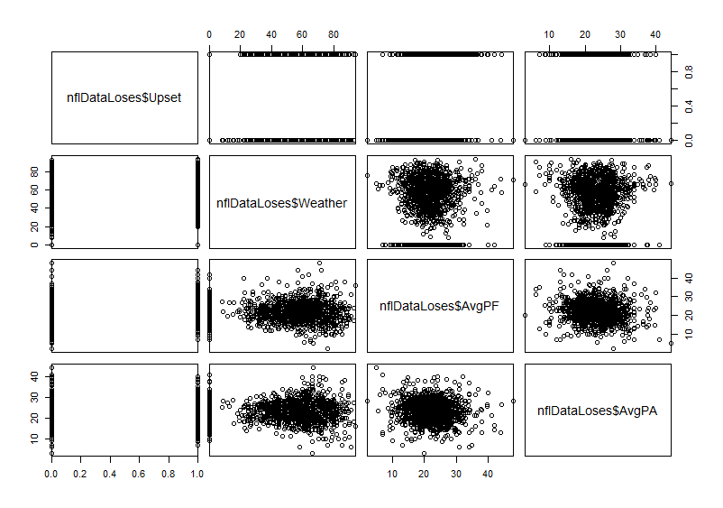
Results: Data Analysis (1 of 4)

Slide 8
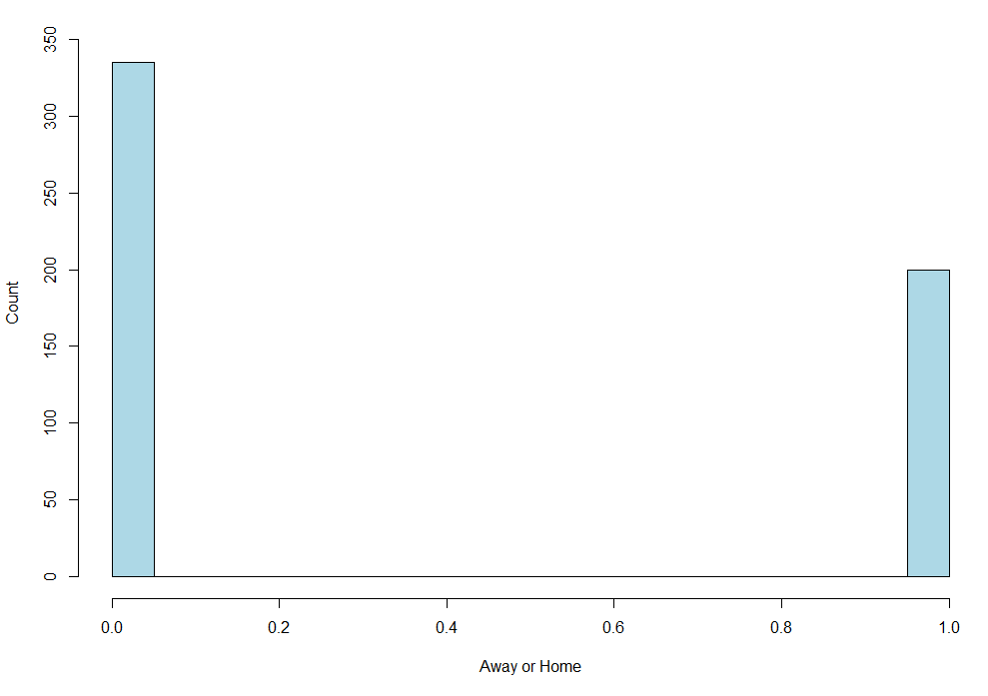
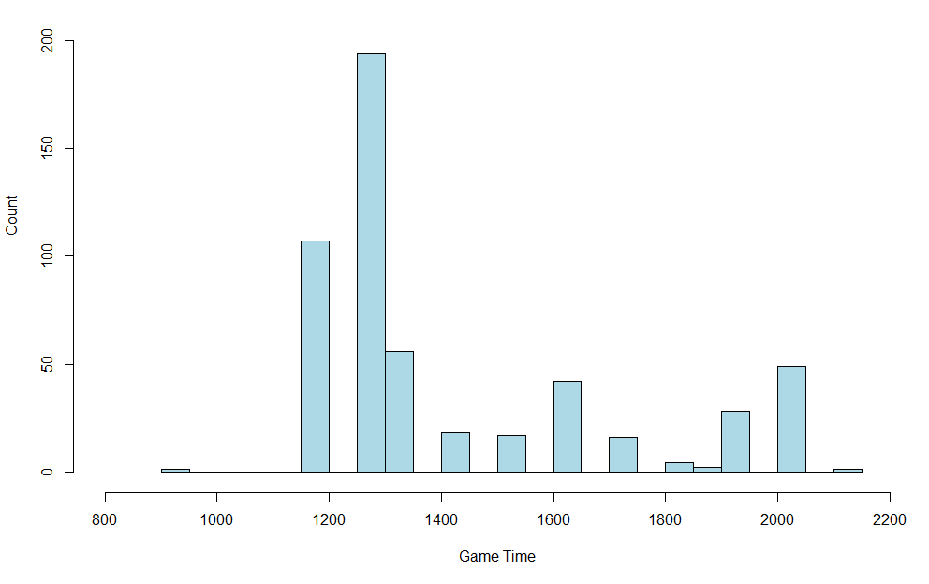
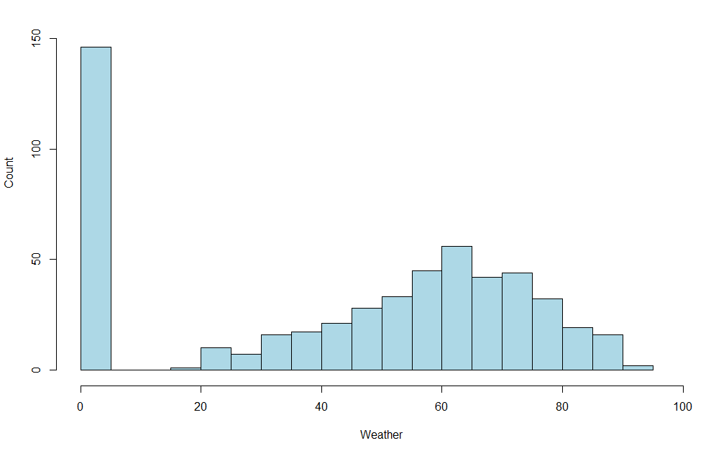
Results: Data Analysis (2 of 4)
Notes:
Left: Histogram of Upset Wins Weather
Middle: Histogram of Upset Wins Game Time
Right: Histogram of Upset Wins Away (0) or Home (1)

Slide 9
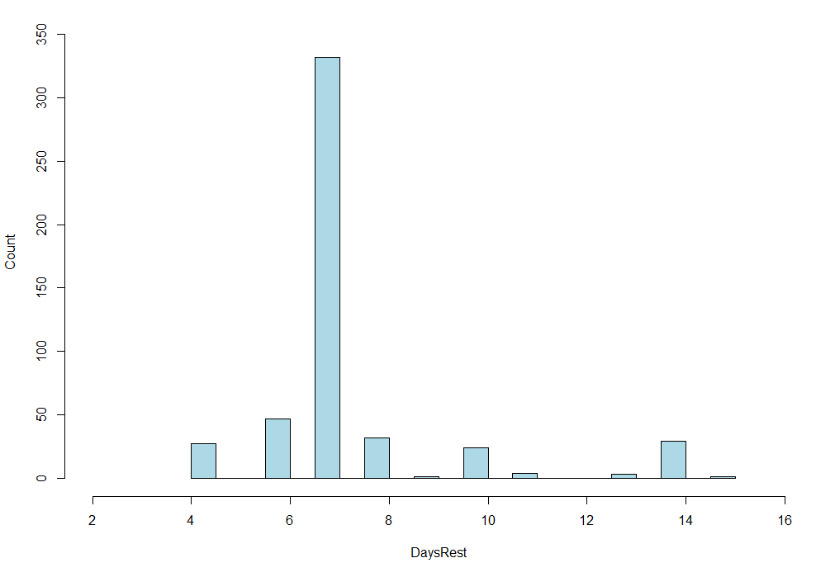
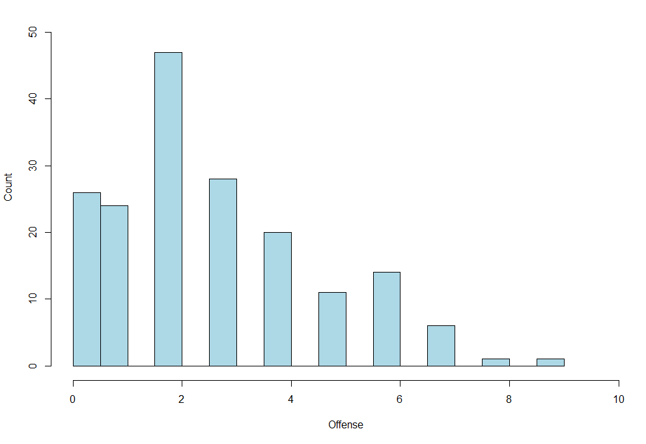
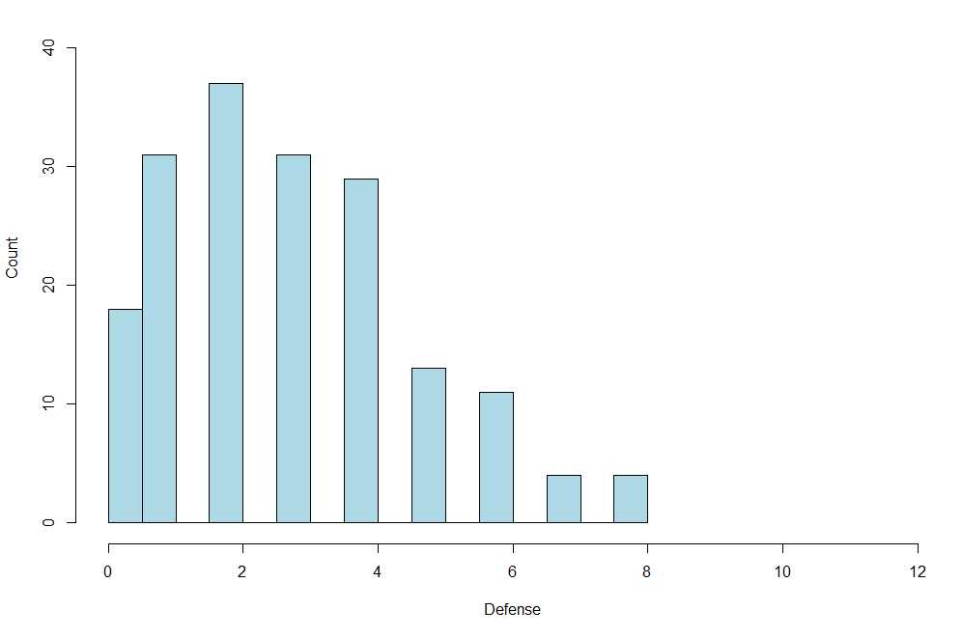
Results: Data Analysis (3 of 4)
Notes:
Left: Histogram of Upset Loses Days Rest
Middle: Histogram of Upset Loses Offensive Injuries
Right: Histogram of Upset Loses Defensive Injuries
Injuries->Game Time decisions

Slide 10
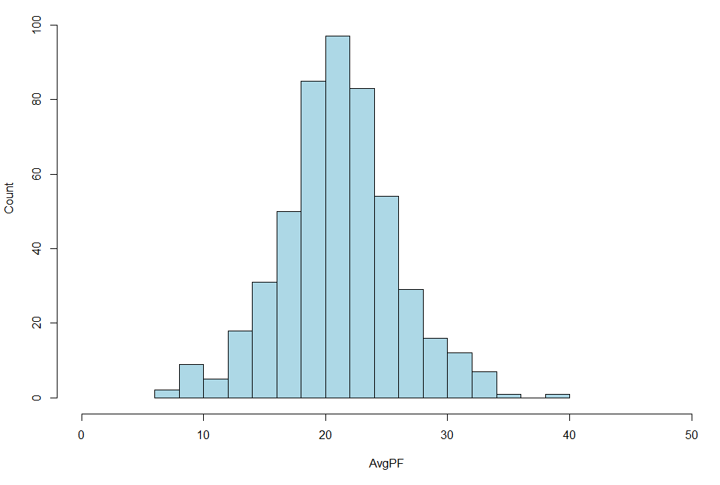
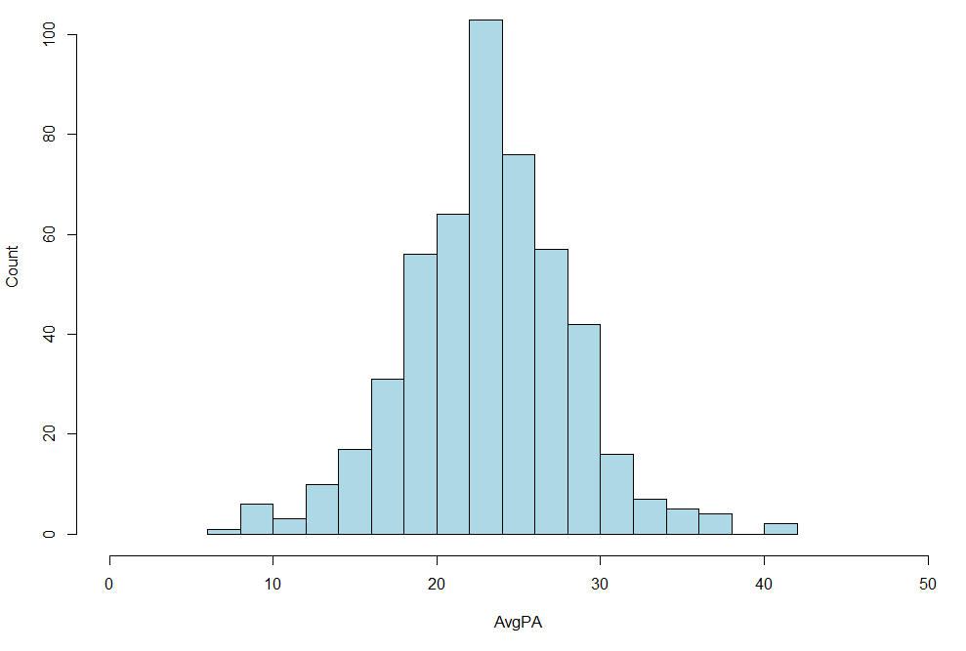
Results: Data Analysis (4 of 4)
Notes:
Left: Histogram of Upset Wins Average Points For
Right: Histogram of Upset Wins Average Points Against

Slide 11
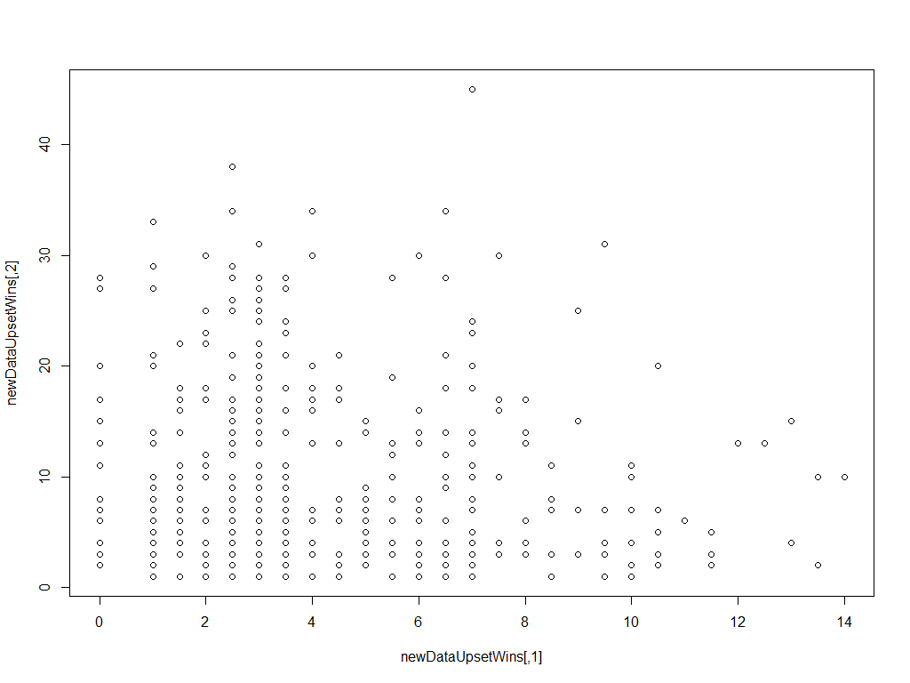
Results: Upset Amount – Clustering
Notes:
Before any clustering algorithms … Odds vs UpsetAmt

Slide 12
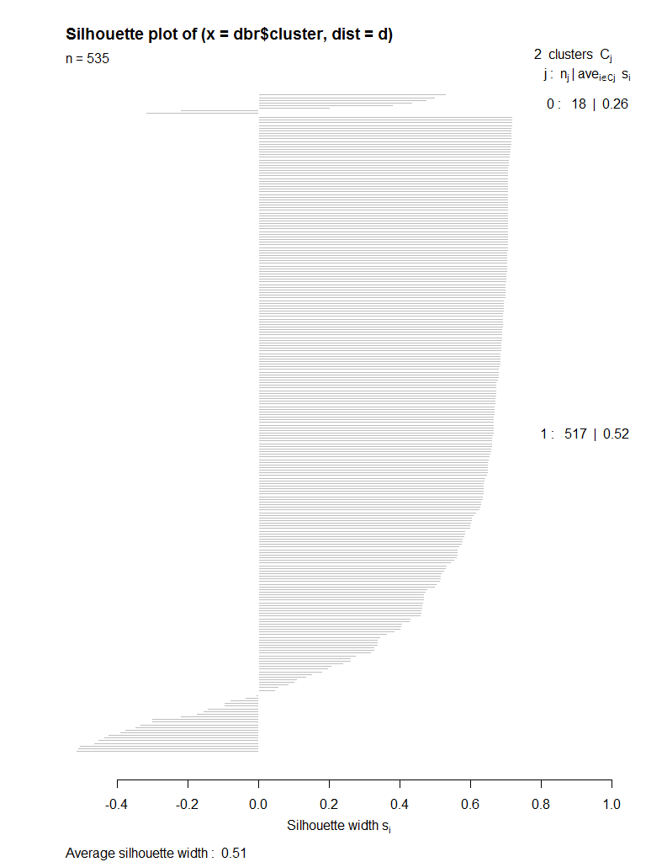
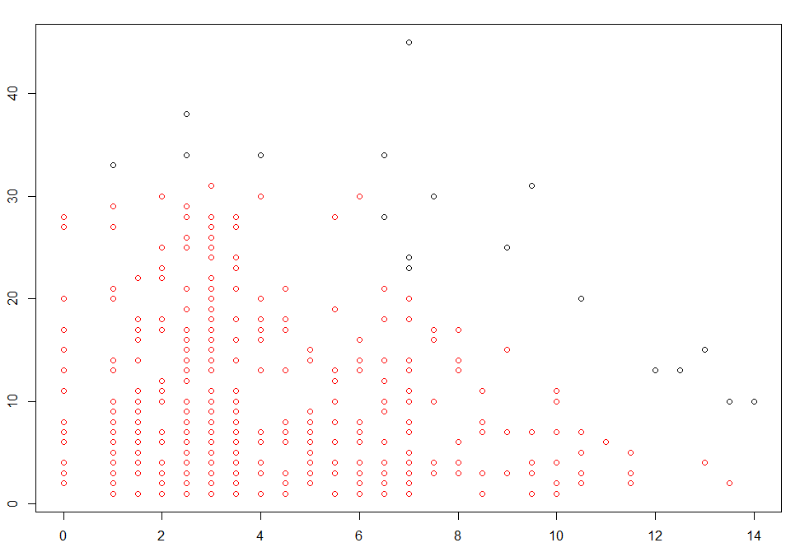
Results: Upset Amount – Clustering with DBSCAN
Notes:
2 clusters … red and black
A few outliers

Slide 13
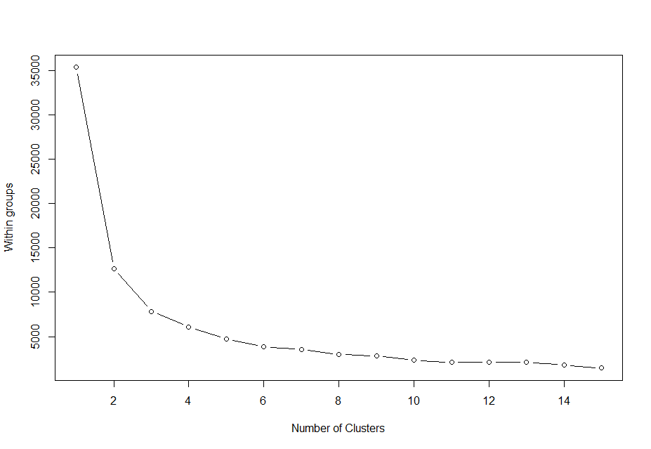
Results: Upset Amount – Clustering with K-Means (1 of 4)

Slide 14
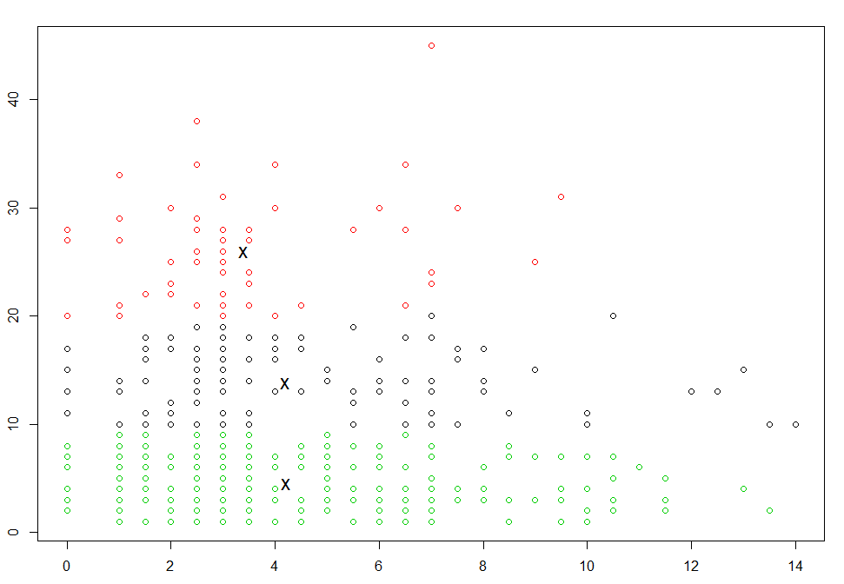
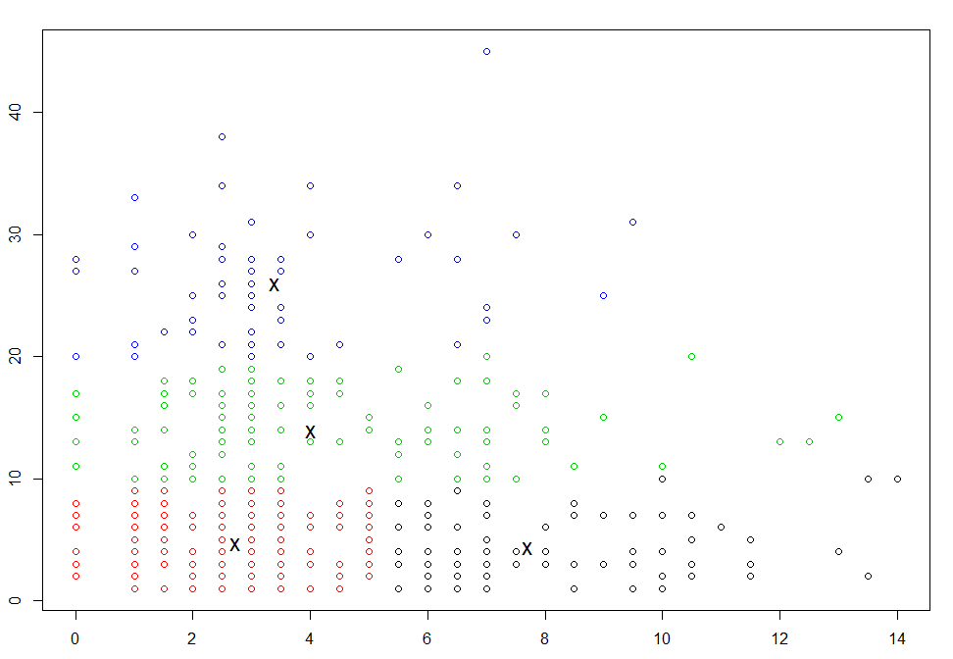
Results: Upset Amount – Clustering with K-means (2 of 4)
K-Means Clustering k=3
K-Means Clustering k=4

Slide 15
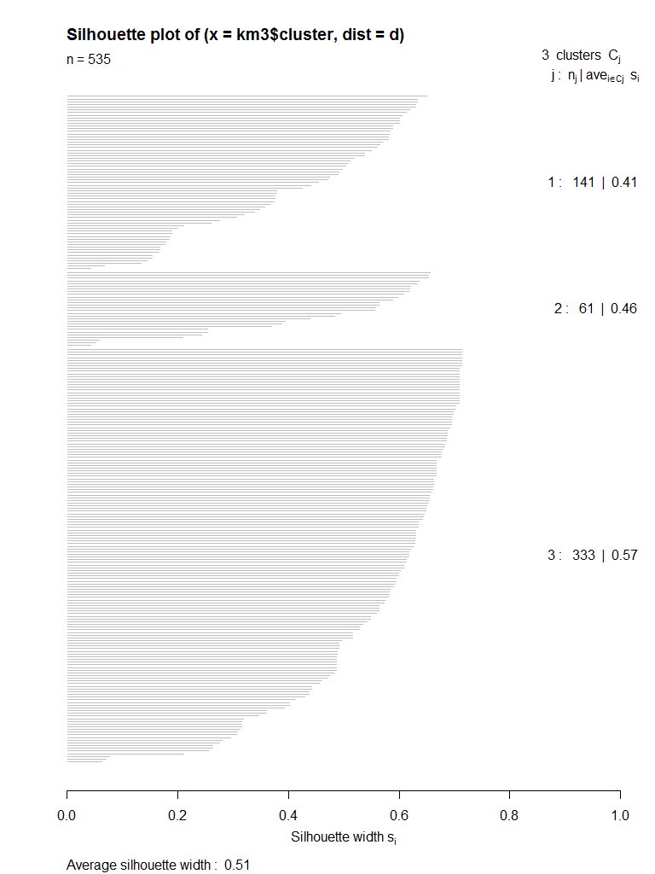
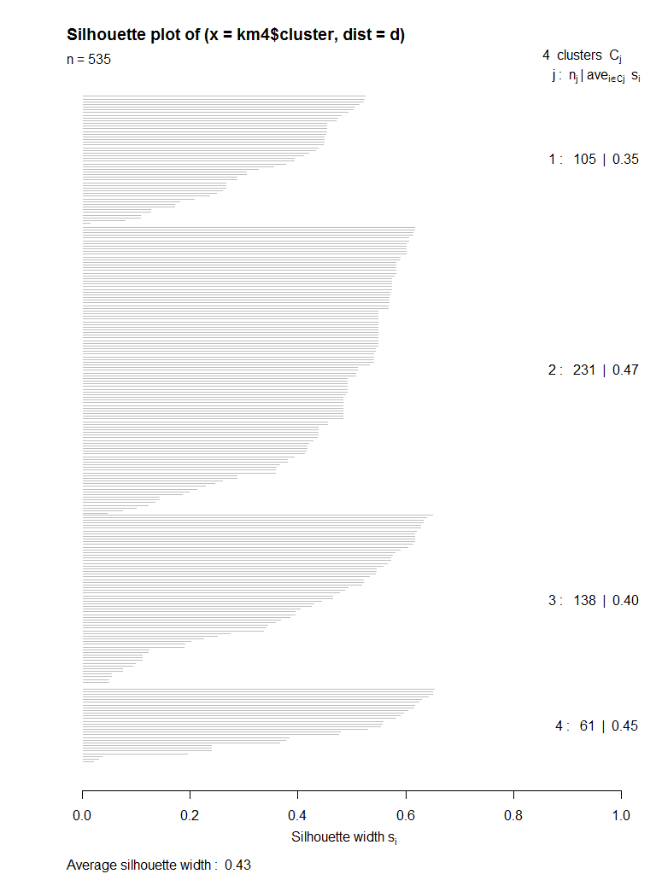
Results: Upset Amount – Clustering with K-means (3 of 4)
K-Means Clustering k=3
K-Means Clustering k=4

Slide 16
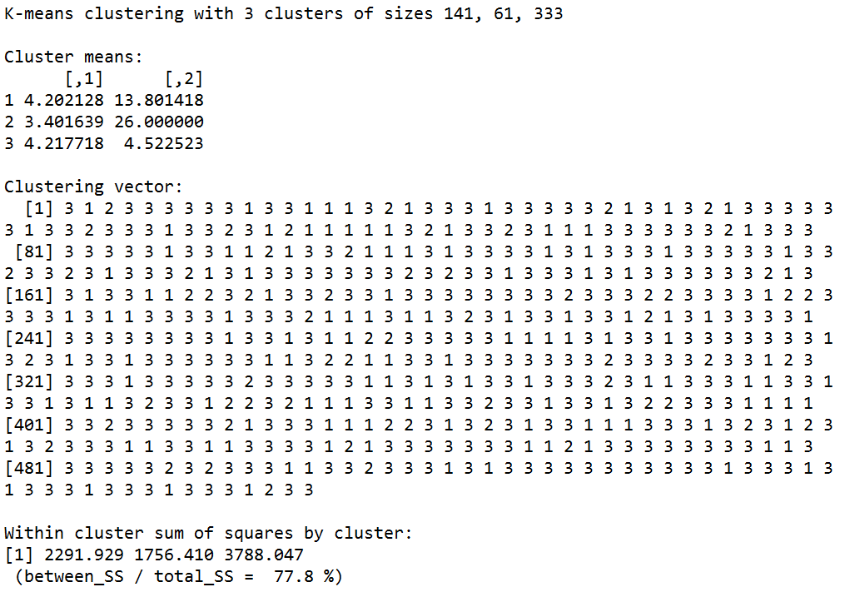
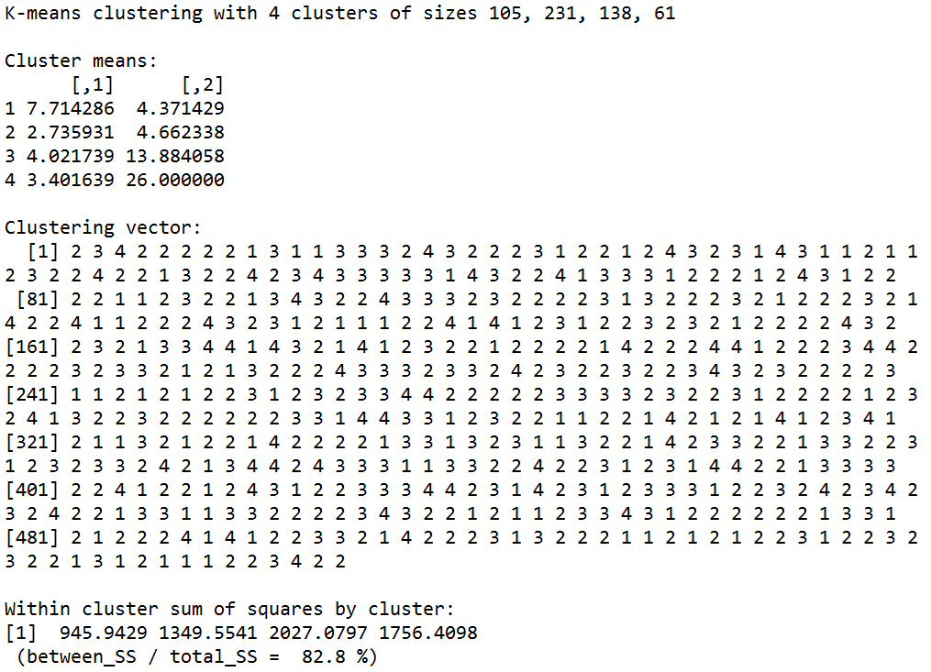
Results: Upset Amount – Clustering with K-Means (4 of 4)
K-Means Clustering k=3
K-Means Clustering k=4

Slide 17
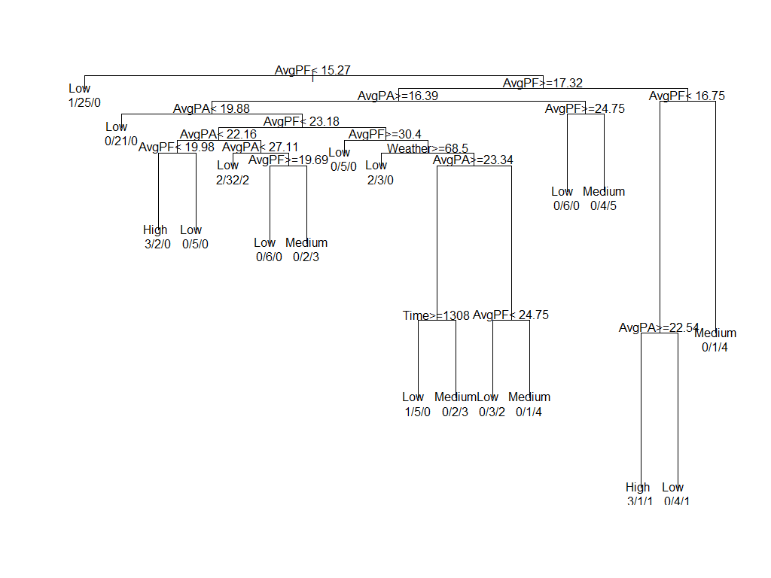
Results: Upset Amount – Classification with Decision Tree (1 of 2)

Slide 18
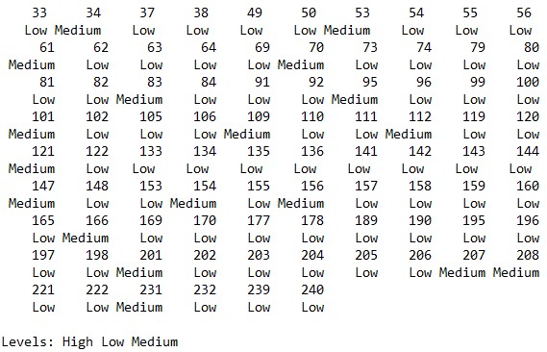
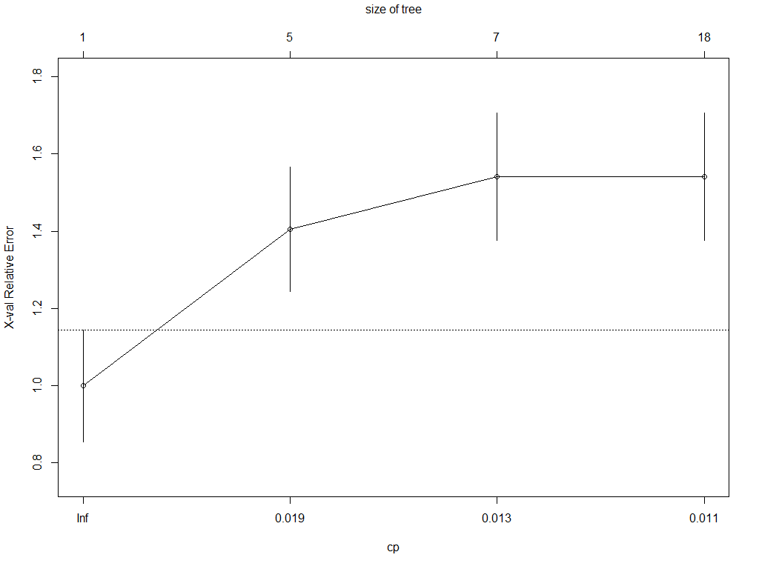

Results: Upset Amount – Classification with Decision Tree (2 of 2)

Slide 20
Results: Upset Amount – Classification with Naïve Bayes (x of X)

Slide 21
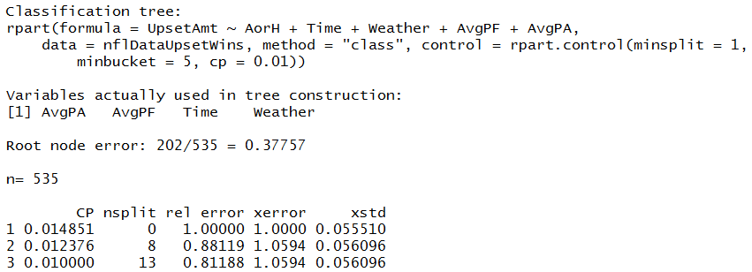
Results: Data Analysis (x of X)

Slide 22
Results: Upset Amount – Classification with Naïve Bayes (x of X)

Slide 23
Conclusion
<insert conclusions here>

Slide 24
Question
<insert here>

